Slide 1
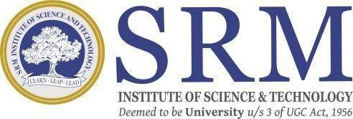
SRM INSTITUTE OF SCIENCE AND TECHNOLOGY SCHOOL OF COMPUTING
DEPARTMENT OF COMPUTER SCIENCE AND ENGINEERING
18CSP109L - MAJOR PROJECT
“AI NEXUS: A BLUEPRINT FOR MICROENTERPRISE BRILLIANCE”
Guide name: Ms. Nidhi Pandey
Designation: Assistant Professor
Department: CSE
Batch ID: 24MP2603099
Reg. No:RA2011026030099
Name: Lahari Krishnam
Reg. No:RA2011026030116
Name: Smaranika Udgata
Reg. No:RA2011026030117
Name: Avantika Gupta
Reg. No:RA2011026030119
Name: Suraj Singh

Slide 2
ABSTRACT
This major project explain how artificial intelligence (AI) can transform microenterprises across sectors.
Develop a practical framework for microenterprises to adopt and implement AI technologies.
Consider industry-specific needs, financial constraints, and organizational culture. Investigating the impact of AI adoption on microenterprises, focusing on workforce dynamics, job roles, and community engagement.
Emphasize ethical considerations and responsible AI practices.

Slide 3
INTRODUCTION
Welcome to our Major project exploring how Artificial Intelligence (AI) can transform microenterprises. By combining insights from business, economics, and technology, we're developing a practical framework tailored to the unique needs of microenterprises, addressing challenges and opportunities.
Our research considers not only the technological aspects but also delves into the socio-economic impact, including workforce dynamics and ethical considerations. The goal is to provide a practical guide for microenterprise owners, policymakers, and stakeholders interested in responsibly harnessing the benefits of AI for growth and innovation.

Slide 4
Problem statement and Objectives
Microenterprises play a vital role in the economy, but they face challenges adapting to evolving technologies. While Artificial Intelligence (AI) offers transformative potential, integration poses difficulties. Existing literature lacks insight into how microenterprises, with industry-specific nuances and resource constraints, can strategically adopt and leverage AI for sustained success.
This Project aims to fill this gap, creating a tailored framework to unlock AI's potential for efficiency, innovation, and competitiveness in this critical sector.

